Slide 1
Our People Strategy
2024-2028
Belong Excel Thrive

Slide 2
Context
Aligned with other enabling strategies.
Ongoing consultation process
Initial scoping for themes takes cognisance of people risk analysis, opportunities and horizon scanning, informed by key University business drivers whilst remaining flexible and adaptive to the changing environment and new priorities the University will face.
Seeks to shape and cultivate a culture that supports the University’s ambitions that is values driven, whilst aligning new structures and ways of working with appropriate organisational development interventions to face a range of challenges
Develops eight themes to support the University Strategic Plan. These are not set in isolation and are interdependent with other strategies and themes within the People Strategy

Slide 3
Context
Delivery through Partnering with Our Faculties, Schools and Departments
Our Ambition
Supporting our people requires significant joint working and collaboration but mostly importantly shared ownership and understanding centrally and locally. Local people plans/aims need to be developed within an agreed corporate framework that acknowledges different challenges and opportunities that various functions face.
Seeks to encourage devolved and distributed leadership throughout the University in addressing both local and corporate issues and places ownership of the priorities to those best placed to ensure they are achieved.

Slide 4
Context
Will need to reflect and adapt to the resource allocation available over the 4 years to determine priorities and pace of change. Some areas of the strategy will span multiple years to embed because of resources and organisational and cultural change that will be required.
Strategy Plan to support with clear milestones
Set of KPIs including corporate givens – Athena Swan, Disability Confident, Wellbeing along with specific KPIs for Our People strategy.

Slide 5
Vision
People Services Vision:
Working collaboratively with the collegium, including leaders, staff and key internal and external stakeholders we will shape and build a unique, fully inclusive, change ready, values driven, socially responsible, with highly skilled and engaged colleagues, people centric work setting contributing to the University’s ambitious plans for 2028 seeking to maximise institutional excellence in all that we do.

Slide 6
Living Our Values and Developing Our Culture
Our Equality, Diversity and Inclusion Commitment
Supporting and Maximising Our Performance
People
Strategy
Themes
Our Leaders
Our Wellbeing and Safety
Hearing Our Employee Voice and Engaging Our People
Transforming Our Work Environment
Our Social Responsibility and the Environment
High level actions supplementing the themes will be identified, between 15 - 20. These will be those that have the greatest impact on meeting the University’s ambition. They will be underpinned by numerous other operational actions and work streams.

Slide 7
Themes and Ambitions

Slide 8
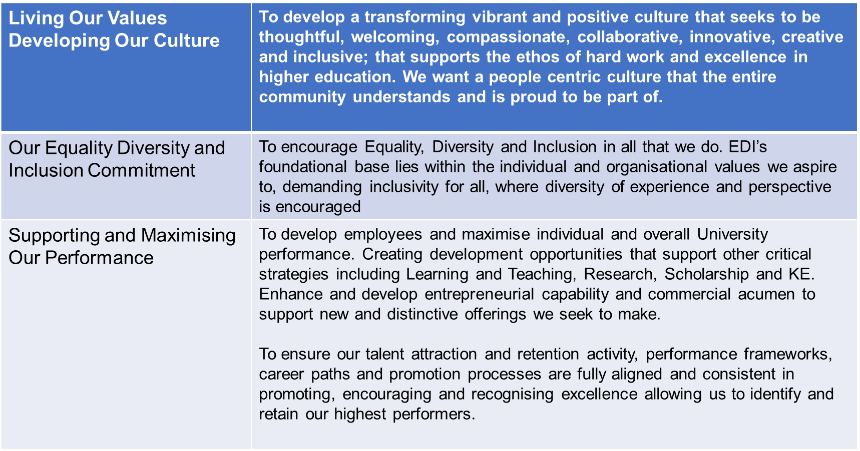
Living Our Values Developing Our Culture | To develop a transforming vibrant and positive culture that seeks to be thoughtful, welcoming, compassionate, collaborative, innovative, creative and inclusive; that supports the ethos of hard work and excellence in higher education. We want a people centric culture that the entire community understands and is proud to be part of.
Our Equality Diversity and Inclusion Commitment | To encourage Equality, Diversity and Inclusion in all that we do. EDI’s foundational base lies within the individual and organisational values we aspire to, demanding inclusivity for all, where diversity of experience and perspective is encouraged
Supporting and Maximising Our Performance | To develop employees and maximise individual and overall University performance. Creating development opportunities that support other critical strategies including Learning and Teaching, Research, Scholarship and KE. Enhance and develop entrepreneurial capability and commercial acumen to support new and distinctive offerings we seek to make. To ensure our talent attraction and retention activity, performance frameworks, career paths and promotion processes are fully aligned and consistent in promoting, encouraging and recognising excellence allowing us to identify and retain our highest performers.

Slide 9
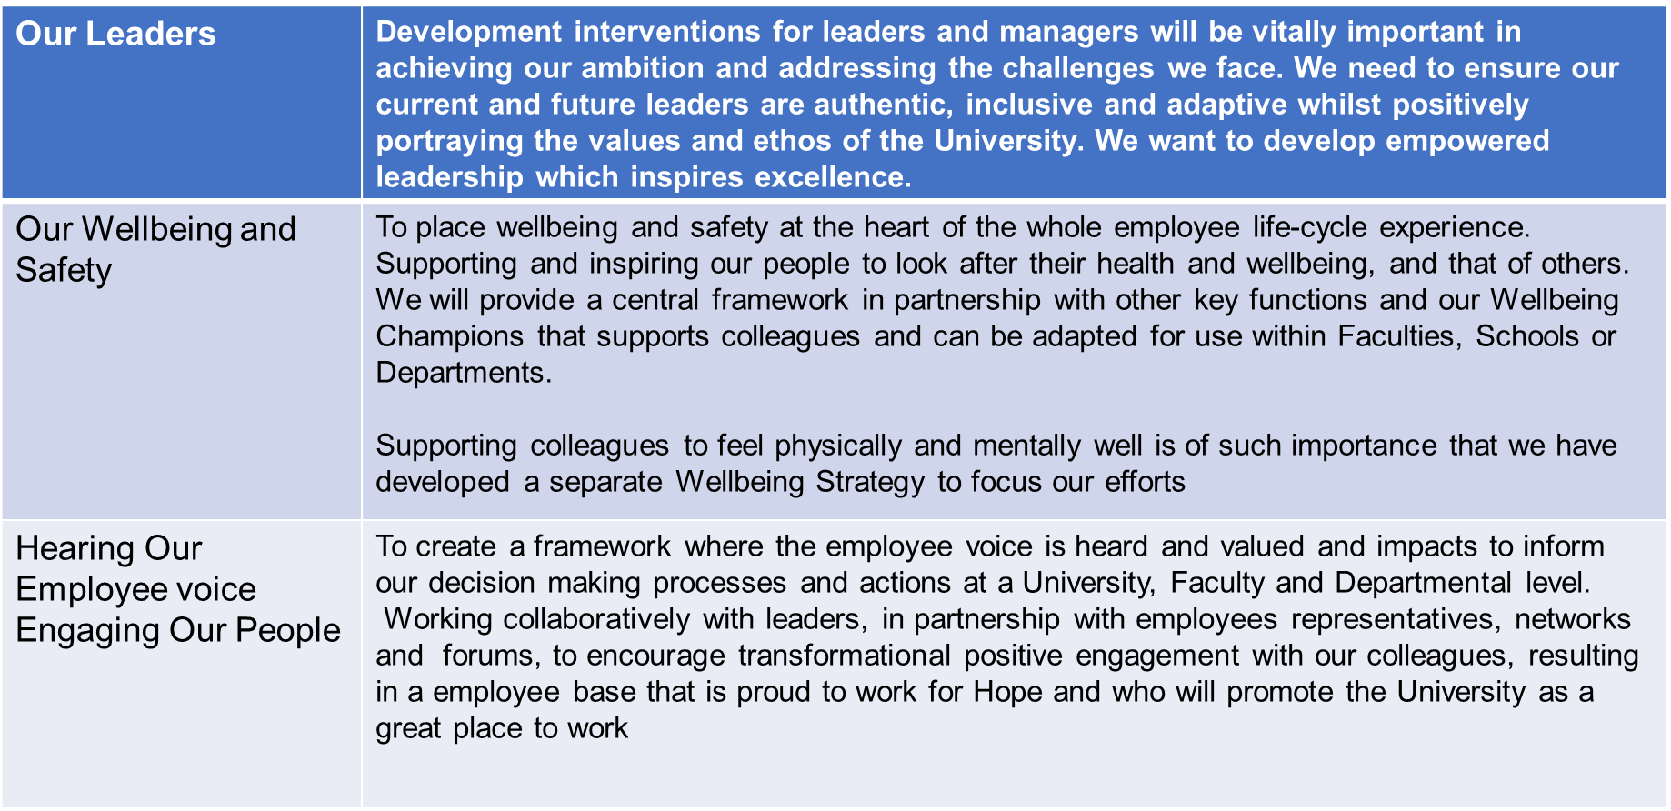
Our Leaders | Development interventions for leaders and managers will be vitally important in achieving our ambition and addressing the challenges we face. We need to ensure our current and future leaders are authentic, inclusive and adaptive whilst positively portraying the values and ethos of the University. We want to develop empowered leadership which inspires excellence.
Our Wellbeing and Safety | To place wellbeing and safety at the heart of the whole employee life-cycle experience. Supporting and inspiring our people to look after their health and wellbeing, and that of others. We will provide a central framework in partnership with other key functions and our Wellbeing Champions that supports colleagues and can be adapted for use within Faculties, Schools or Departments. Supporting colleagues to feel physically and mentally well is of such importance that we have developed a separate Wellbeing Strategy to focus our efforts
Hearing Our Employee voice Engaging Our People | To create a framework where the employee voice is heard and valued and impacts to inform our decision making processes and actions at a University, Faculty and Departmental level. Working collaboratively with leaders, in partnership with employees representatives, networks and forums, to encourage transformational positive engagement with our colleagues, resulting in a employee base that is proud to work for Hope and who will promote the University as a great place to work

Slide 10
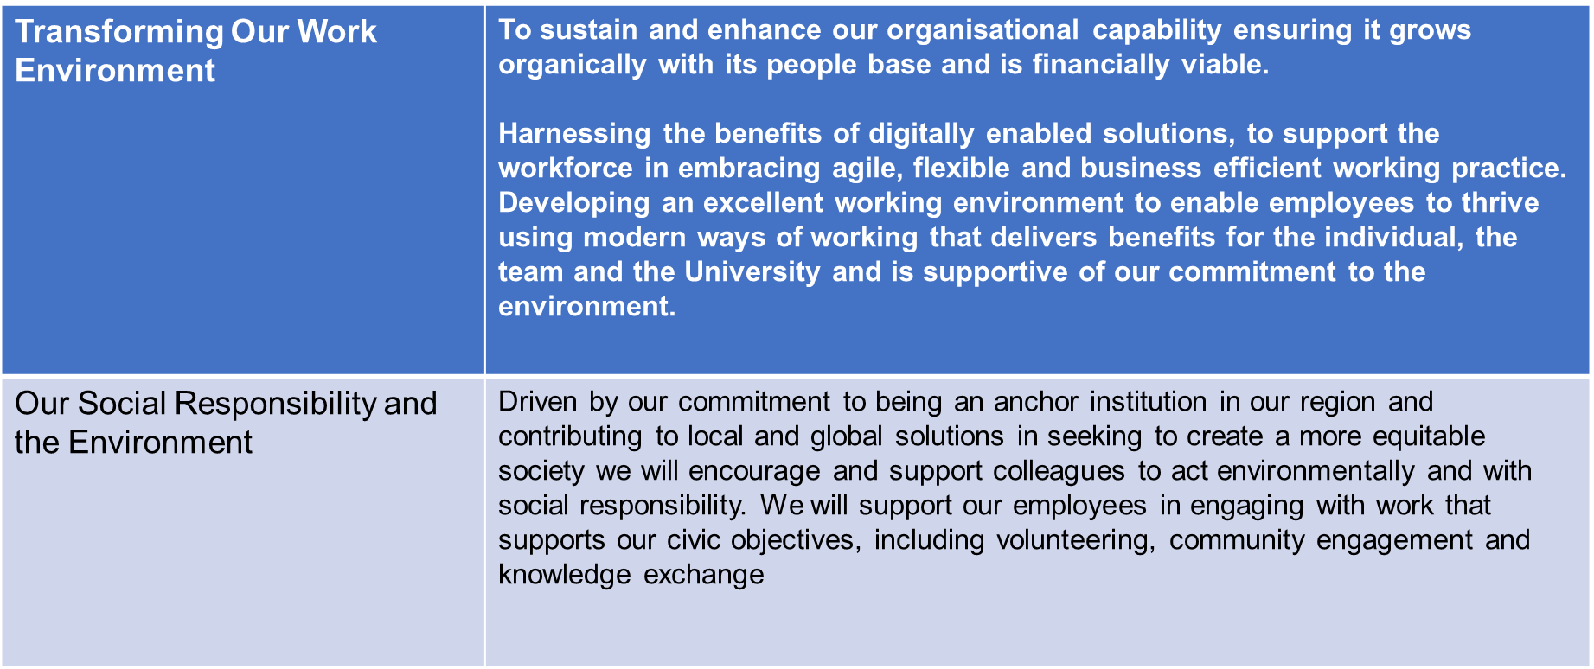
Transforming Our Work Environment | To sustain and enhance our organisational capability ensuring it grows organically with its people base and is financially viable. Harnessing the benefits of digitally enabled solutions, to support the workforce in embracing agile, flexible and business efficient working practice. Developing an excellent working environment to enable employees to thrive using modern ways of working that delivers benefits for the individual, the team and the University and is supportive of our commitment to the environment.
Our Social Responsibility and the Environment | Driven by our commitment to being an anchor institution in our region and contributing to local and global solutions in seeking to create a more equitable society we will encourage and support colleagues to act environmentally and with social responsibility. We will support our employees in engaging with work that supports our civic objectives, including volunteering, community engagement and knowledge exchange

Slide 11
High Level Actions
There are 14 high level actions throughout the duration of the strategy linked to:
single theme
or
multiple themes
Some examples

Slide 12
High Level Actions
Ensuring staff networks voices are captured and meaningful interventions put in place to support our diverse community recognising inclusion as a vital part of Hope being a healthy university.
Build a culture of continuous improvement where our people understand how high performance contributes to achieving our ambitions and is recognised accordingly
Develop a framework of leadership behaviours that will underpin Hope’s aims setting out the expectations that employees at all levels can have of those in leadership and management roles
Benchmarking Hope’s approach to pay and reward on an annual basis, both across the sector and in our local area
Develop a tailored approach to performance and development for every colleague, enabling them to engage in training, learning and experiences to enhance their personal achievement and contribution to Hope’s ambitions whilst supporting their career development
Conducting an Employee Survey which is valued and well supported by employees. Ensure that the University leadership responds to important issues identified at institutional and school and department level, with the use of mid-year targeted pulse surveys on specific issues when necessary

Slide 13
High Level Actions
Making it easier for employees to provide feedback through more dynamic and energetic approaches to engaging with and listening to employees throughout their lifecycle with us, and ensuring we take visible and timely action when required
Implement Hope’s Wellbeing Strategy and Supporting Plan
Supporting our employees in developing digital capabilities and confidence, allowing them to be equipped for engaging in digital practice & innovation and future ways of working which aligns to the ambitions of our Digital Strategy
Support key employees in developing their entrepreneurial capability and competence and commercial acumen
Ensure people practices are inclusive of Hope’s ambitions for sustainability encouraging employee commitment through development opportunities and tailored performance targets
Support our employees in engaging with work that supports our civic objectives, including volunteering, community engagement and knowledge exchange
Provide Leadership Development programmes that are appropriate for the stage of individual careers inclusive of aspiring future leaders.
Work with various stakeholders to support schools and large departments in the creation, ownership and delivery of appropriate employee initiatives and plans that accurately identify current and future employee’s requirements, encouraging professional development and being future ready for the challenges that arise

Slide 14
Key Performance Indicators

Slide 15
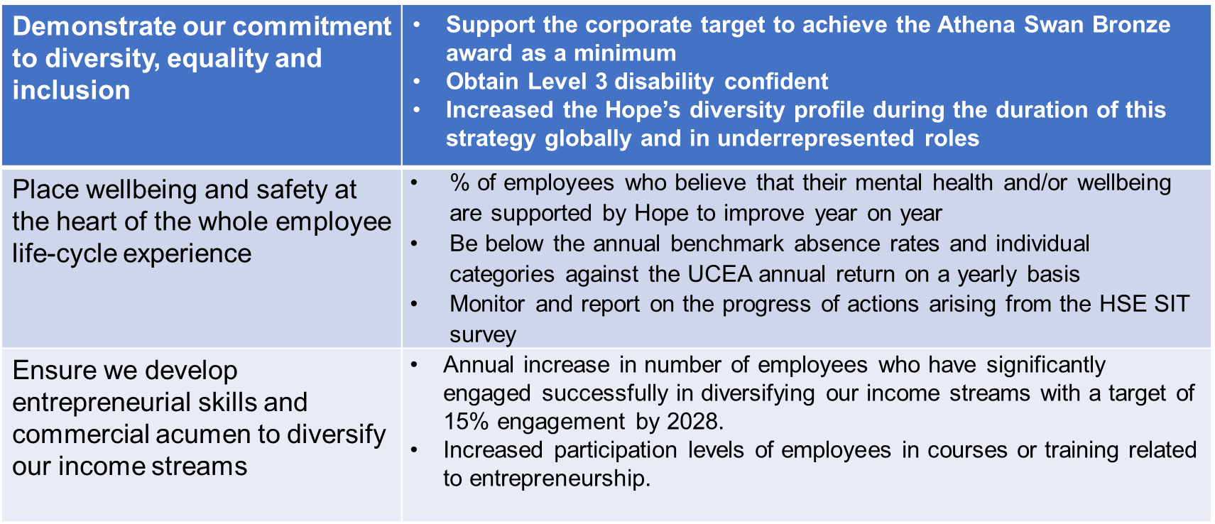
Demonstrate our commitment to diversity, equality and inclusion | Support the corporate target to achieve the Athena Swan Bronze award as a minimum Obtain Level 3 disability confident Increased the Hope’s diversity profile during the duration of this strategy globally and in underrepresented roles
Place wellbeing and safety at the heart of the whole employee life-cycle experience | % of employees who believe that their mental health and/or wellbeing are supported by Hope to improve year on year Be below the annual benchmark absence rates and individual categories against the UCEA annual return on a yearly basis Monitor and report on the progress of actions arising from the HSE SIT survey
Ensure we develop entrepreneurial skills and commercial acumen to diversify our income streams | Annual increase in number of employees who have significantly engaged successfully in diversifying our income streams with a target of 15% engagement by 2028. Increased participation levels of employees in courses or training related to entrepreneurship.

Slide 16
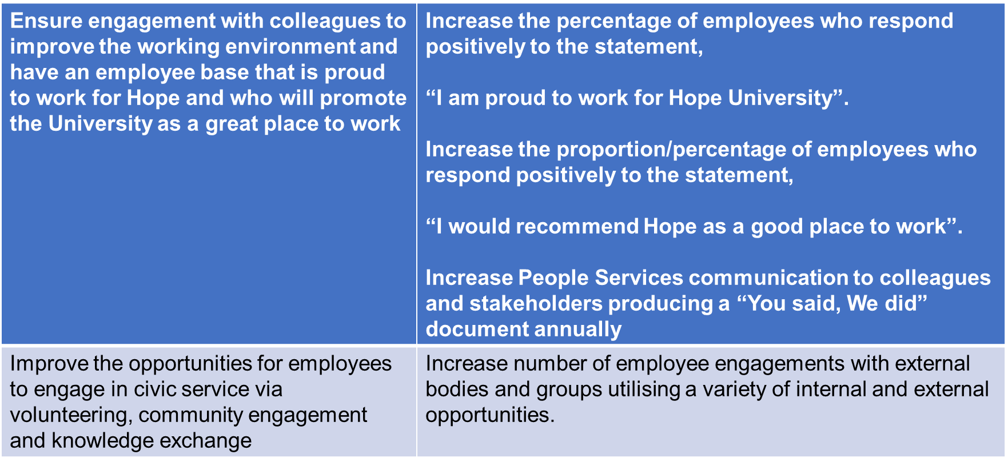
Ensure engagement with colleagues to improve the working environment and have an employee base that is proud to work for Hope and who will promote the University as a great place to work | Increase the percentage of employees who respond positively to the statement, “I am proud to work for Hope University”. Increase the proportion/percentage of employees who respond positively to the statement, “I would recommend Hope as a good place to work”. Increase People Services communication to colleagues and stakeholders producing a “You said, We did” document annually
Improve the opportunities for employees to engage in civic service via volunteering, community engagement and knowledge exchange | Increase number of employee engagements with external bodies and groups utilising a variety of internal and external opportunities.

Slide 17
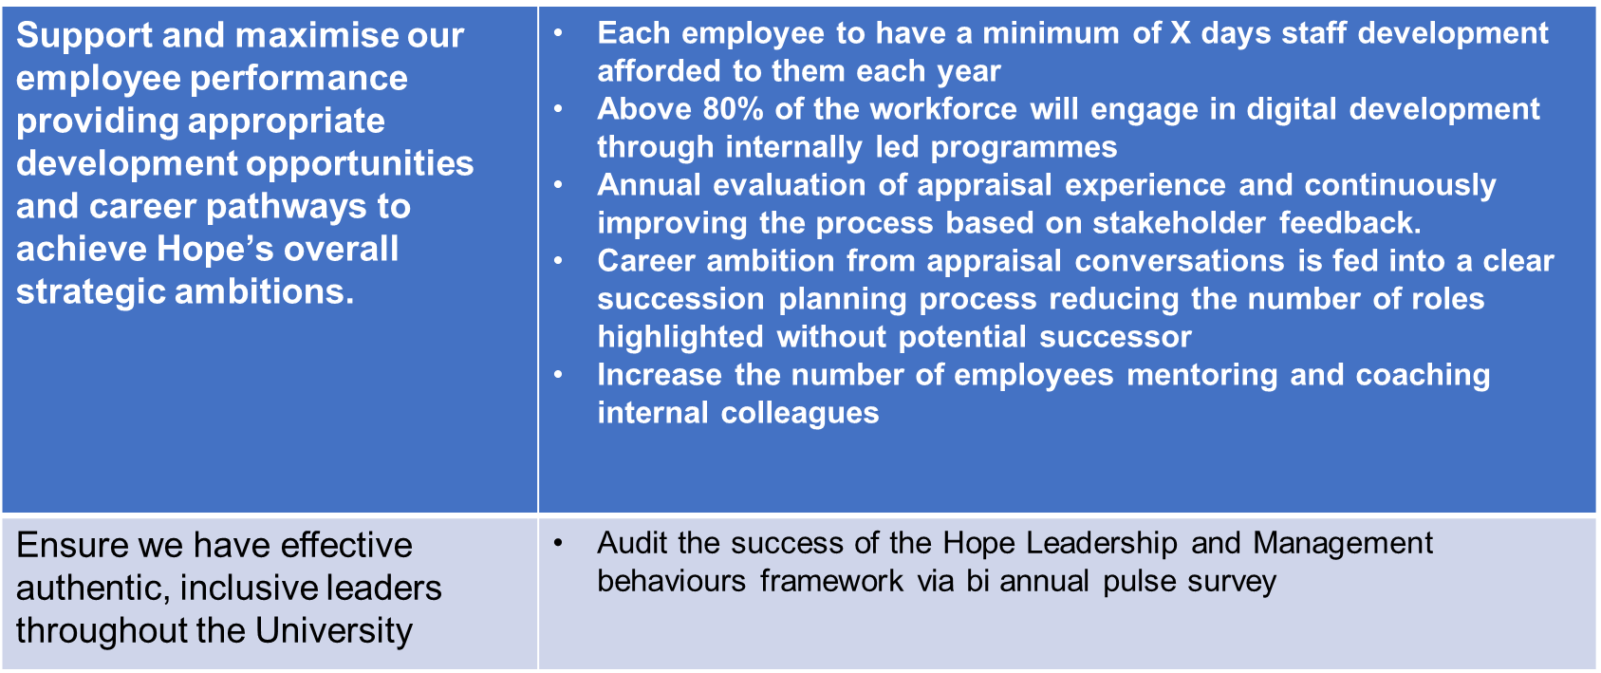
Support and maximise our employee performance providing appropriate development opportunities and career pathways to achieve Hope’s overall strategic ambitions. | Each employee to have a minimum of X days staff development afforded to them each year Above 80% of the workforce will engage in digital development through internally led programmes Annual evaluation of appraisal experience and continuously improving the process based on stakeholder feedback. Career ambition from appraisal conversations is fed into a clear succession planning process reducing the number of roles highlighted without potential successor Increase the number of employees mentoring and coaching internal colleagues
Ensure we have effective authentic, inclusive leaders throughout the University | Audit the success of the Hope Leadership and Management behaviours framework via bi annual pulse survey

Slide 18
Next Steps
Review feedback and amend accordingly
Meet again with Unions
Present at UEB
Seek approval at Staffing Committee
Approval at Council

